Slide 1
Wireless Networks
Lecture 13
Fundamentals of Cellular Networks (Part III)

Slide 2
Outlines
Last lecture review
Interference and system capacity
Co-channel interference and capacity
Adjacent channel interference and capacity
Channel Planning for Wireless System

Slide 3
Last lecture review
Channel Assignment Strategies
Handoff Strategies
When to handoff
1G, BS based
2G or today’s, Mobile-Assisted
Prioritizing Handoff
Guard channels concept
Queuing handoff requests
Practical handoff considerations
Umbrella cell
Cell dragging

Slide 4
Interference and system capacity
Sources of interference
Another mobile in the same cell
Call in progress in a neighboring cell
Other BS operating in same frequency
Another non-cellular system leaks energy into cellular frequency band
Interference on voice channels causes cross-talk
On control channels, interference leads to missed and blocked calls
A major bottleneck in increasing capacity
Two major types
Co-channel and adjacent channel interference

Slide 5
Co-channel interference and system capacity
Co-channel cells: cells that use the same set of frequencies and interference is called co-channel interference
By increasing SNR, co-channel can not be combated
To reduce it, co-channel cells must be separated by a min distance
When size of each cell is approximately same and BS transmit at same power, co-channel interference ratio is independent of transmission power and is a function of radius of cell (R) and distance between centers of nearest co-channel cell (D)

Slide 6
By increasing the ratio of D/R,
separation between co-channel cells relative to coverage distance of a cell is increased.
Thus interference is reduced.
The parameter Q (co-channel reuse ratio) is related to cluster size. Thus for a hexagonal geometry
A small value of Q provides larger capacity since N is cluster size
Large value of Q improves transmission quality due to smaller level of co-channel interference
A trade-off must be made between these two objectives

Slide 7
Let i₀ be the number of co-channel interfering cells, then the signal-to-interference ratio for a mobile receiver which monitors a forward channel is
where S is the desired signal power from desired BS and I_{i} is the interference power caused by i_{th} interfering co-channel cell

Slide 8
Average received signal strength at any point decays as a power law of the distance of separation between transmitter and receiver
Average received power P_{r} at a distance d from the transmitting antenna is approx
Where Po is the power received at a close-in reference point at a small distance d_{o} from the transmitting antenna, n is path loss exponent ranging between 2 and 4

Slide 9
Now consider co-channel cell interference
If D_{i} is the distance of i^{th} interferer from the mobile, the received power will be proportional to (D_{i})^{-n}
When the transmit power of each BS is equal and the path loss exponent is same throughout coverage then S/I can be approximated as

Slide 10
Considering only the first layer of interfering cells, which are equidistant D from the desired BS
Eqn 4 implies to
It relates S/I to cluster size N, which in turn determines the overall capacity of the system

Slide 11
For US AMPS system, tests indicate that for sufficient voice quality S/I should be greater or equal to 18 dB.
By using Eqn 5, in order to meet this requirement, N should be at least 6.49 assuming n=4.
Thus a minimum cluster size of 7 is required to meet S/I requirement of 18 dB
It should be noted Eqn 5 is based on hexagonal cell geometry

Slide 12
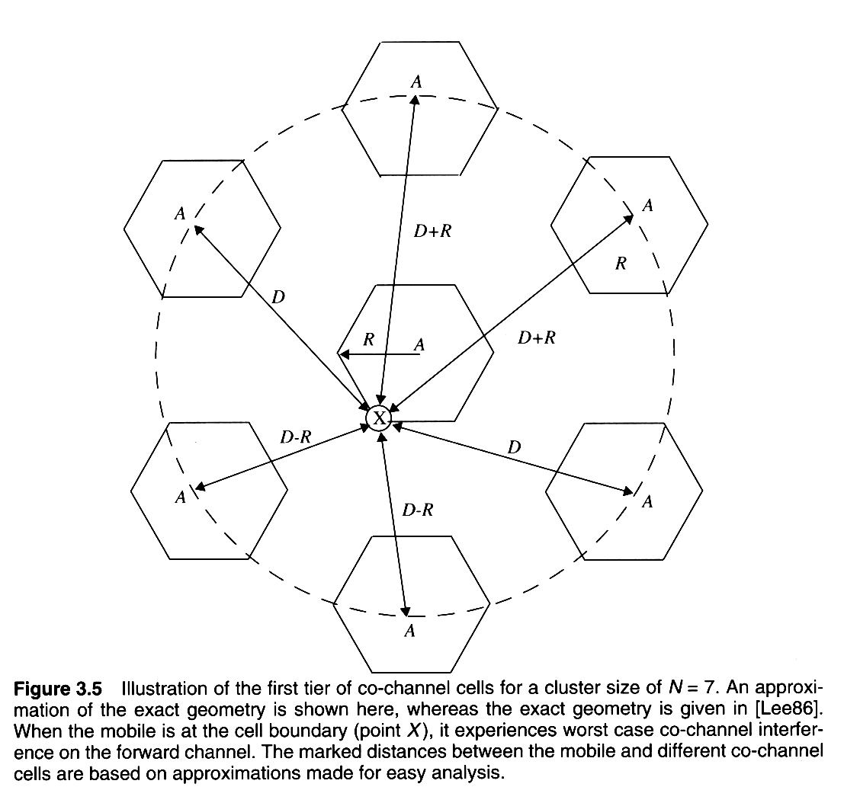
For 7-cell cluster, hexagonal cell geometry layout
Mobile is at the boundary of the cell

Slide 13
The worst case S/I ratio can be approximated using Eqn 4
The above Eqn can be rewritten in terms of co-channel reuse ratio Q as
For N=7, the value of Q is 4.6
The worst case S/I is approximated as 49.56 (17 dB) using Eqn 7, where exact solution using Eqn 4 is 17.8 dB.

Slide 14
Example
If S/I is required 15 dB for satisfactory forward channel performance, what is the frequency reuse factor and cluster size that should be used for maximum capacity if path loss exponent n = 4 and n = 3? Assuming 6 co-channel cells in first tier at same distance from desired BS
n = 4, lets consider 7-cell reuse
Using Eqn. 1, reuse ratio is 4.583
Using 5, S/I = 1/6 x (4.583)^4 = 75.3 = 18.66 dB
Since this is greater than min required, N=7 can be used
n = 3, first consider 7-cell reuse
S/I = 1/6 x (4.583)^3 = 16.04 = 12.05 dB
Since this is less than min required,
Next possible value of N is 12-cell reuse (i = j = 2)
Using Eqn. 1, reuse ratio is 6.0
S/I = 1/6 x (6)^3 = 36 = 15.56 dB
Since this is greater than min required S/I, So N=12 is used

Slide 15
Channel Planning for Wireless Systems
Generally available spectrum is divided into channels used throughout a country or continent
Control channels
5% of total devoted for initiating, requesting or paging a call, data messages
Voice channels
95% dedicated for revenue generating traffic
Channels may be assigned by wireless carrier in any manner depending on particular propagation conditions or services it wishes to offer
However, control channels are not allowed to be used as voice channels or vice versa
Control channels are vital for any successful launch of call, the frequency reuse strategy or S/I is more conservative than voice channels
While voice channels are assigned only 7-cell reuse, control channels are allocated using 21-cell reuse

Slide 16
Key feature of CDMA systems is that cluster size N = 1, frequency reuse planning is not as difficult as for TDMA or 1G systems
However, most practical CDMA use some sort of limited frequency reuse due to ill-behaved propagation conditions
For example interfering channels on same channel can create interference overload that exceeds the dynamic range of CDMA power control capabilities, leading to dropped calls
Most popular approach is to use f1/f2 cell planning, where nearest neighbor cells use channels that are different from its closest neighbor
This would require mobiles to make hard handoff

Slide 17
In CDMA a single 1.25 MHz channel carries 64 simultaneous voice channels
CDMA system has dynamic time varying coverage region depending on instantaneous number of users, known as breathing cell
The wireless engineer has to carefully plan the coverage and signal levels for best and worst cases of serving cell as well as neighboring cell from both coverage and interference view.
Breathing cell can lead to abrupt dropped calls
Hence, the engineer must make difficult decision of power levels and thresholds

Slide 18
Adjacent channel interference
Interference resulting from signals which are adjacent in frequency
It results from imperfect receiver filters which allow nearby frequencies to leak into passband
It is more serious if the transmitter is more close to the user’s receiver listening to desired channel
This is near-far effect
A nearby transmitter captures the receiver of subscriber.
Or mobile close to BS transmits on adjacent channel to one being used by a weak mobile

Slide 19
Adjacent channel interference can be minimized by careful filtering and channel assignment
A cell need not be assigned channels adjacent in frequency
By keeping frequency separation in a given cell between channels as large as possible, interference can considerably minimized
By sequentially assigning successive channels to different cells, channel allocation schemes are able to separate channels in a cell as many as N
Some assigning strategies also avoid use of adjacent channels in neighboring cell sites.

Slide 20
If reuse factor (1/N) is large i.e. N is small, the separation may not be sufficient to keep intf within tolerable limits.
For example if a close-in mobile is 20 times as close to BS as another mobile and energy has leaked to passband, S/I at BS for weak mobile is approx
S/I = (20)^{-n}
For n-4, this is -52 dB
If filter of BS receiver has a slope of 20 dB/octave then intf must be displaced 6 times the passband bandwidth from the center to achieve 52 dB attenuation
This implies more than 6 channels separation are needed for an acceptable S/I level

Slide 21
Summary

